Slide 1

Data Visualization of Bird Strikes
Presented By: Uzman Ansari

Slide 2

Introduction
Bird strikes, defined as collisions between birds and aircraft, present a significant threat to aviation safety. These incidents occur when an aircraft in flight or during take-off or landing comes into contact with birds or other wildlife, such as bats or ground animals. Bird strikes are a common phenomenon and can lead to severe consequences, particularly for smaller aircraft where the impact can cause substantial structural damage.

Slide 3
Identify Trends and Patterns: Yearly Analysis: Analyse the number of bird strikes reported each year to identify any increasing or decreasing trends. Temporal Patterns: Determine the time of day, seasons, and specific months when bird strikes are most frequent.
Record ID
Aircraft: Type
Airport: Name
Altitude bin
Aircraft: Make/Model
Wildlife: Number struck
Wildlife: Number Struck Actual
Effect: Impact to flight
Flight Date
Effect: Indicated Damage
Aircraft: Number of engines?
Aircraft: Airline/Operator
Origin State
When: Phase of flight
Conditions: Precipitation
Remains of wildlife collected?
Remains of wildlife sent to Smithsonian
Remarks
Wildlife: Size
Conditions: Sky
Wildlife: Species
Pilot warned of birds or wildlife?
Cost: Total $
Feet above ground
Number of people injured
Is Aircraft Large?

Slide 4
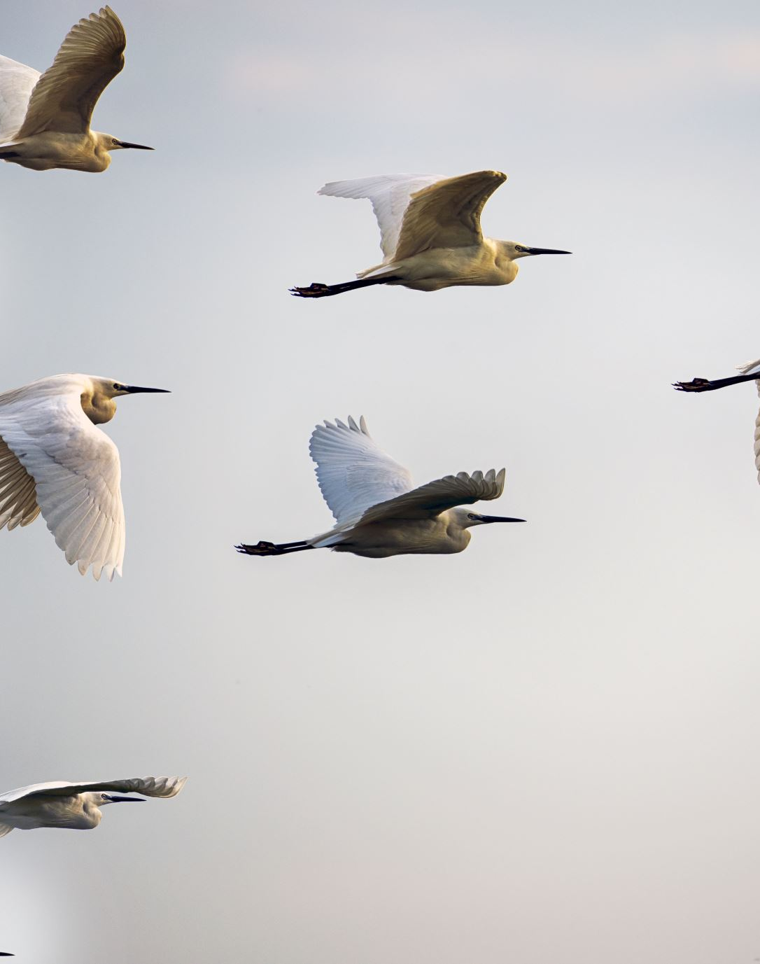
Bird Strikes between 2000 – 2011
Case Studies
Visuals Depicting the Number of Bird Strikes
Yearly Analysis & Bird Strikes in the US
Top 10 US Airlines in terms of having encountered bird strikes
Airports with most incidents of bird strikes – Top 50
Yearly Cost Incurred due to Bird Strikes:
When do most bird strikes occur?
Altitude of aeroplanes at the time of strike
Phase of flight at the time of the strike.
Average Altitude of the aeroplanes in different phases at the time of strike
Effect of Bird Strikes & Impact on Flight
Effect of Strike at Different Altitude
Were Pilots Informed? & Prior Warning and Effect of Strike Relation

Slide 5
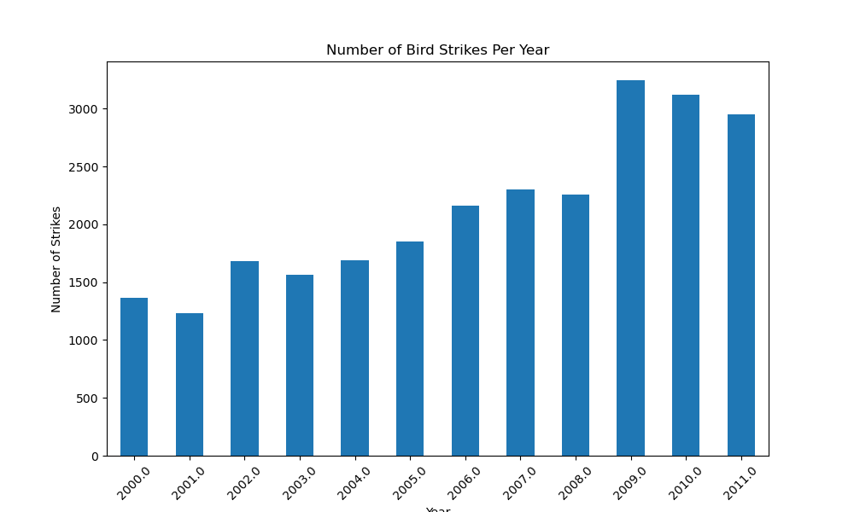
Number of Bird Strikes Per Year
Highest:
2009: This year has the highest number of bird strikes.
2010: This year has the second-highest number of bird strikes.
Lowest:
2001: This year has the lowest number of bird strikes.
2000: This year has the second-lowest number of bird strikes.

Slide 6
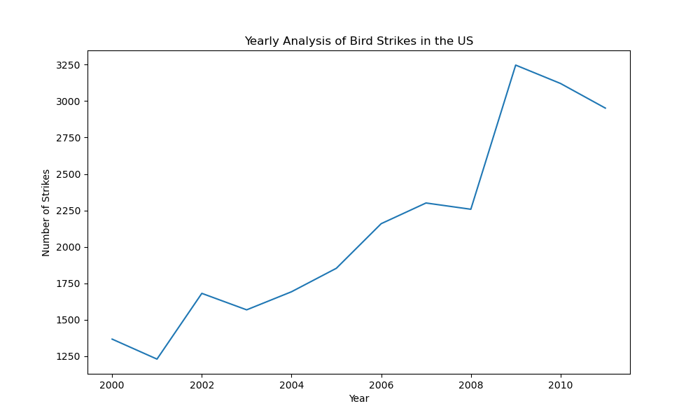
Yearly Analysis of Bird Strikes in the US
Peak 2009 as 3250 aprox

Slide 7
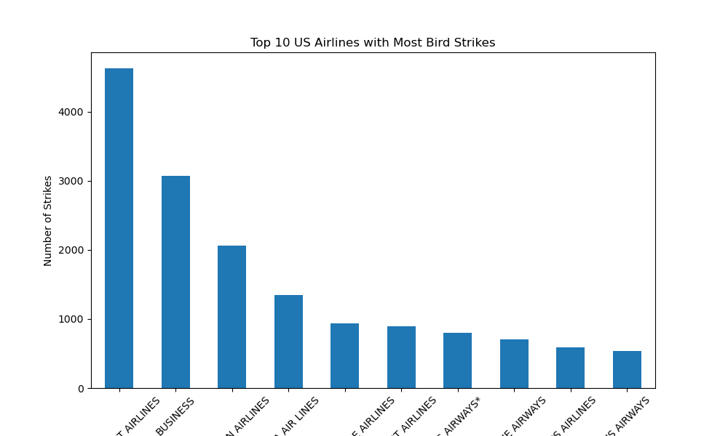
Top 10 US Airlines with Most Bird Strikes
SOUTHWEST AIRLINES
BUSINESS AIRLINES

Slide 8
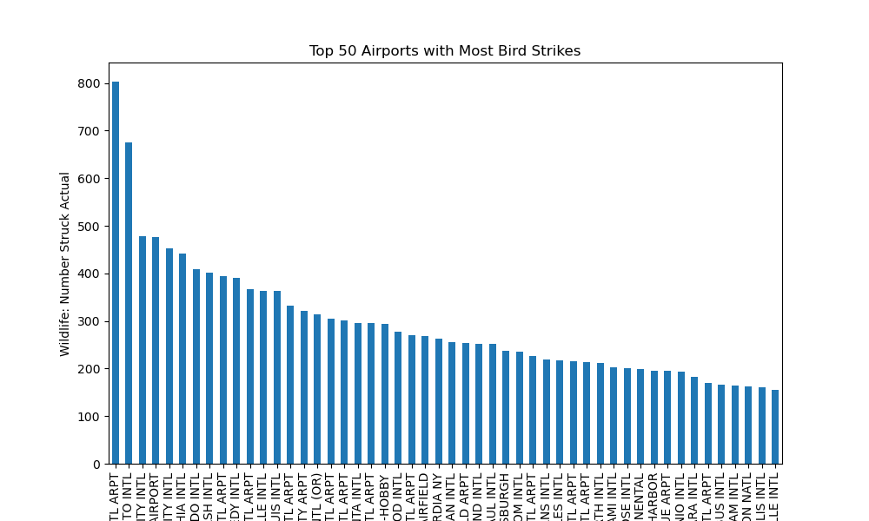
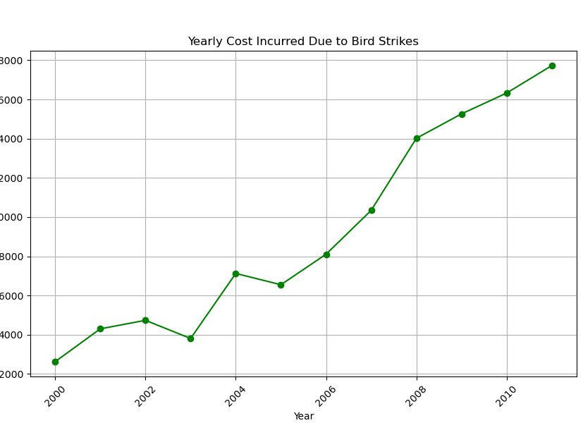
Yearly Cost Incurred Due to Bird Strikes
Top 50 Airports with Most Bird Strikes
TOP AIRPORTS: DALLAS/FORT WORTH INTERNATIONAL, SACRAMENTO INTERNATIONAL

Slide 9
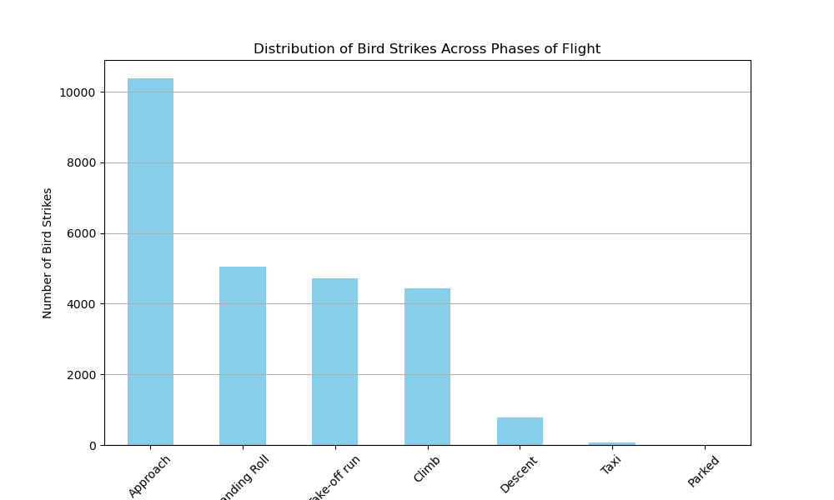
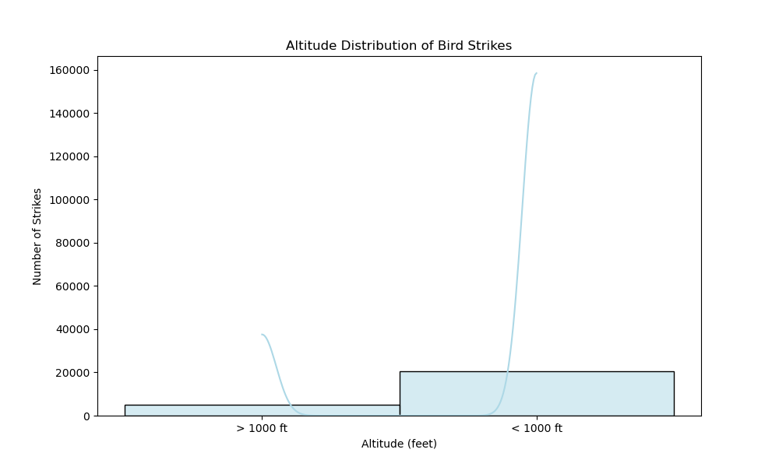
Highest: The "Approach" phase has the highest number of bird strikes, with nearly 10, 000 strikes. Lowest: The "Taxi" phase has the lowest number of bird strikes, with just over 1,000 strikes.
< 1000 ft: This category has the highest number of bird strikes, with nearly 160,000 strikes.
> 1000 ft: This category has significantly fewer bird strikes, with around 20,000 strikes.

Slide 10
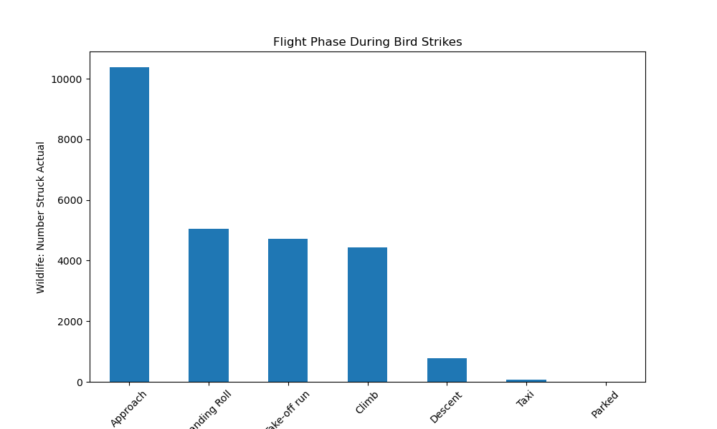
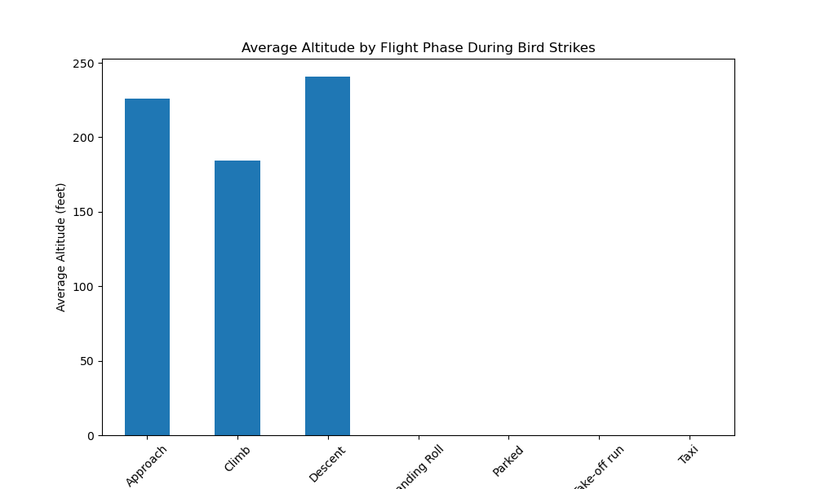
Approach: The Average Altitude During Bird Strikes In The Approach Phase Is Around 225 Feet.
Climb: The Average Altitude During Bird Strikes In The Climb Phase Is Approximately 180 Feet.
Descent: The Average Altitude During Bird Strikes In The Descent Phase Is About 240

Slide 11
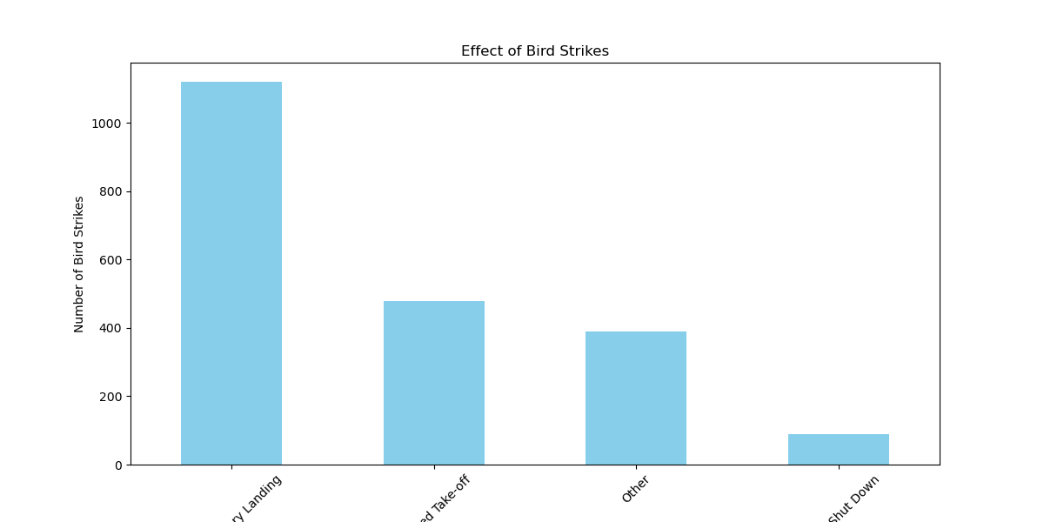
Highest:
Precautionary Landing: This category has the highest number of bird strikes.
Aborted Take-off. This category has the second-highest number of bird strikes.
Lowest:
Engine Shut Down. This category has the lowest number of bird strikes.
Other : This category has the second-lowest number of bird strikes.

Slide 12
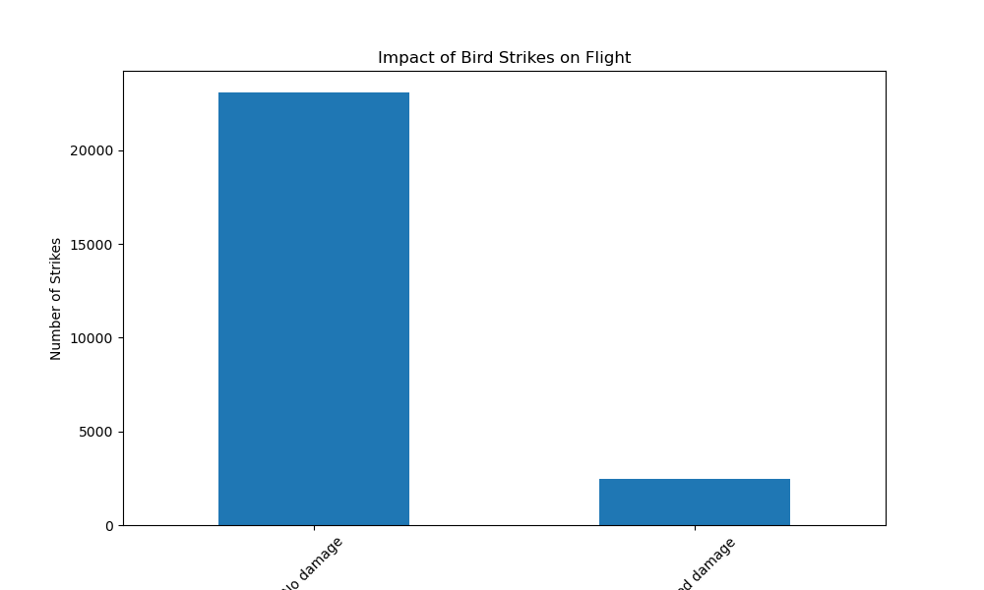
Impact of Bird Strikes on Flight
The Highest Number Of Bird Strikes, With More Than 20,000 Strikes. But No Damage
It Has A Significantly Lower Number Of Bird Strikes, With Less Than 5,000 Strikes Caused Damage.

Slide 13
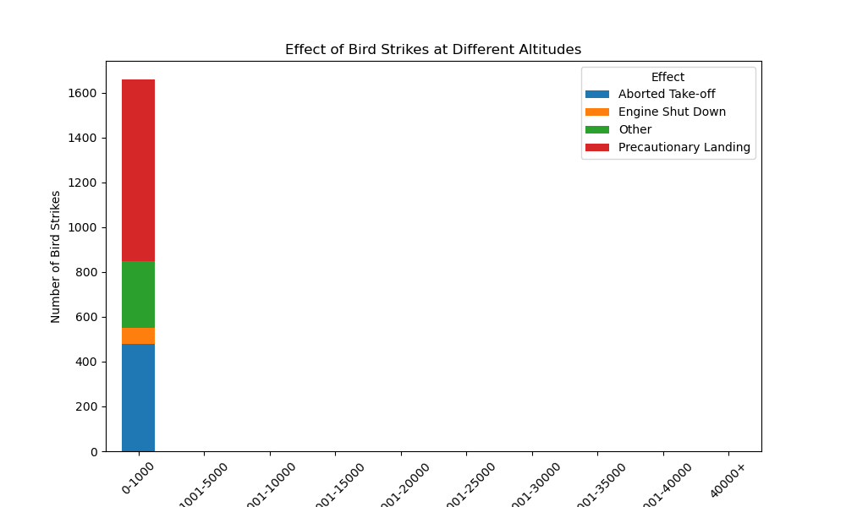
Effect of Bird Strikes at Different Altitudes
Aborted Take-off
Has more than 400 and range between 0 – 1000 Altitude Bin
Engine Shut Down
Has more than 400 and less than 600 range between 0 – 1000 Altitude Bin
Other
Has more than Equal 600 To more than 800 range between 0 – 1000 Altitude Bin
Precautionary Landing
Has more than 800 To 1600 range between 0 – 1000 Altitude Bin

Slide 14
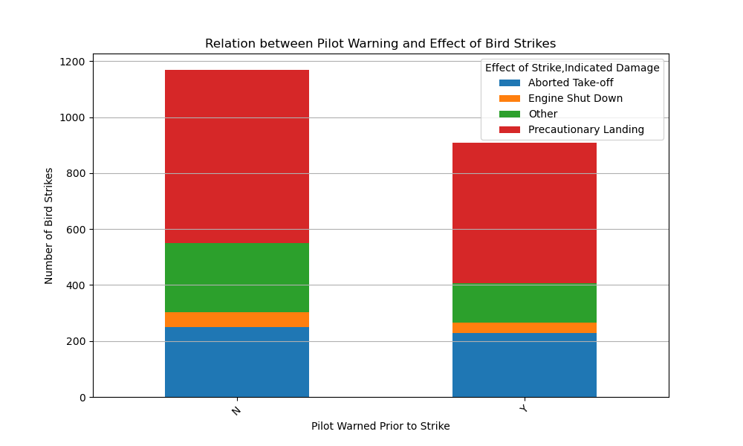
Relation between Pilot Warning and Effect of Bird Strikes
Aborted Take-off
N Has more than 0 more than 200 range
Y Has more than 0 To more than 200
Engine Shut Down
N Has more than 200 Less than 400 range
Y Has more than 200 To Less than 400
Other
N Has more than 200 Less than 600
Y Has more than 400 To more than 800
Precautionary Landing
N Has more than 600 To 1200
Y Has more than 400 To more than 800

Slide 15

Thanks, You

